Slide 1

GHANA CIVIL AVIATION AUTHORITY
Safety and Security, Our Prioritty
1st - 30th November 2023
Christian Nii Commey Solomon - [ 040918451 ]
Supervisor : Mrs. Josephine Laryee Larbi
GHANA COMMUNICATION TECHNOLOGY UNIVERSITY

Slide 2

Overview
a comprehensive summary of my internship experiences and observations at the Aeronautical Information Services (AIS) Directorate of the Ghana Civil Aviation Authority
commenced on November 1st 2023 and concluded on November 30th 2023.
During this period, I was afforded the distinct privilege of gaining profound insights into the intricacies of AIS operations and functions.

Slide 3
Civil Aviation
non-military and non-governmental; private and commercial flights.
plays a pivotal role in connecting people, goods, and services.
governed by international standards and national regulations, civil aviation comprises various sectors, from commercial air transport to aerial work and general aviation.
this sector fosters global connectivity , economic growth; prioritizing safety and efficiency in the skies.

Slide 4

Global vs National
GCAA
ICAO
specialised agency of the UN coordinating international air travel.
193 state parties - includes all member states of the United Nations; 36 Council member States
The convention is supported by annexes containing standards and recommended practices (SARPs)
The Ghana Civil Aviation Act 2004, Act 678 establishes Ghana Civil Aviation Authority, among other things, to:
Provide Air Navigation Services (Air Space Management)
License and Certify Flight Operators, Airports, etc. (Safety Regulation)

Slide 5
Ghana Civil Aviation Authority
regulatory agency of Ghana for air transportation
provides air navigation services ; Accra Flight Information Region
(FIR), comprises the airspace over the Republic of Ghana and a large area over the Atlantic Ocean in the Gulf of Guinea.

Slide 6

Restructure
2007
the GCAA was restructured into two bodies, that is, the new Ghana Civil Aviation Authority (GCAA) and the Ghana Airports Company Limited (GACL) on 1st January, 2007.

Slide 7
GCAA vs GACL
GACL
GCAA
Airport development and operations.
Provide Air Navigation Services (Air Space Management)
License and Certify Flight Operators, Airports, etc. (Safety Regulation)

Slide 8
Main Directorates
Safety Regulator (SRD)
Air Navigation Services Provision (ANSP)
overseeing and regulating Civil Aviation Safety
Safety Oversight Department
Accident Investigation Bureau
ATC - prevent collisions; constant communication
AIS - AIP, NOTAM
ATSE - maintenance ; all ground based equipment
Support
Human Resource
Finance
Legal Affairs

Slide 9
Aeronautical Information Services
The objective of the aeronautical information service (AIS) is to ensure the flow of aeronautical data and aeronautical information necessary for global air traffic management (ATM) system safety, regularity, economy and efficiency in an environmentally sustainable manner

Slide 10
Examples of AI
Visualization of navigational and aeronautical data
Radio aids to navigation (NAVAIDs) (frequencies, geospatial info)
Airports Configuration (runways, taxiways, geospatial info, etc)
Special Activity Airspace (SAA), Special Use Airspace (SUA), Memoranda of Agreement (MOAs), Temporary Flight Restrictions (TFRs)
Notices to Airmen (NOTAMs)
Obstructions
Surveys and Procedures

Slide 11
Internship Overview
WEEK 1 (1st - 3rd Nov, 2023)
Orientation on GCAA, Introduction to the AIS directorate and its role within GCAA
Field tour - GCAA, aerodromes,terminals, Airport company
Field tour - ATC Directorate, NOTAM office, Aerocom Office, Doc&Pub
WEEK 2 (6th - 10th Nov, 2023)
Introduction to QMS and the ISO 9000 series
Introduction to the AIS Data Processing System

Slide 12
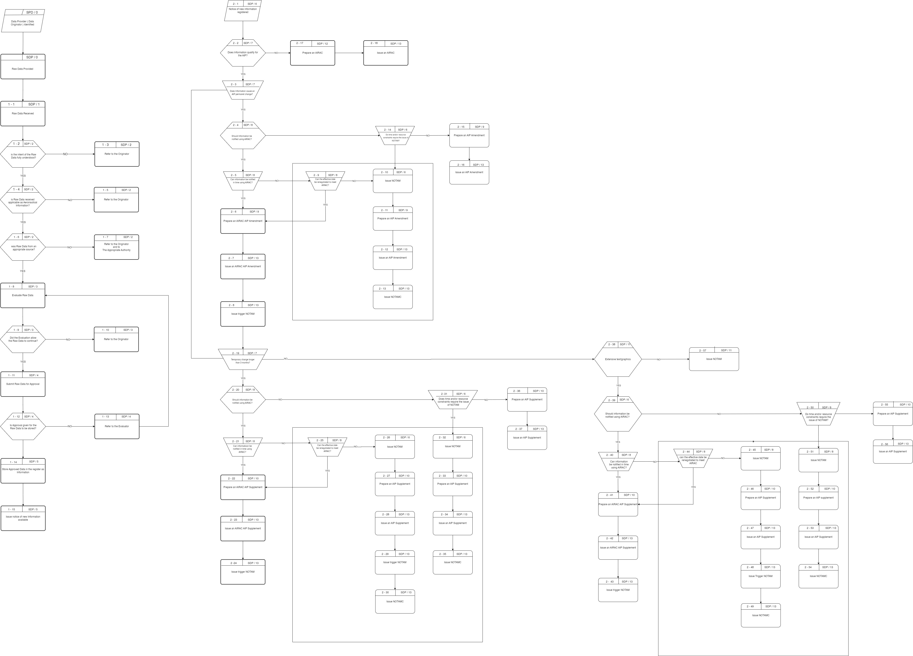

Slide 13
Ghana Civil Aviation Authority
WEEK 3 (13th - 17th Nov, 2023)
Introduction to AIRAC
Preparation of AIP Amendment Using AIS Data Process Model
WEEK 4 (20th - 24th Nov, 2023)
Introduction to Overflight and Landing request processing (Development of Flow Diagrams and System Diagrams)
Processing of Overflight and Landing request via SIM (Based on Flow Diagrams)
Generation of a series A NOTAM with Data Flow Diagram
WEEK 5 (27th - 30th Nov, 2023)
Assessment on internship experience
Made a presentation on internship experience

